Slide 1

PRESENTATION BY
B.TRISANTH SAI
ECE-A/20

Slide 2


THE ART OF EDITING
Refining Your Content for Clarity and Impact

Slide 3

What is editing?
DEFINITON: Reviewing and revising your content for accuracy ,clarity and quality.
PURPOSE: Improve readability,coherence and overall flow.
IMPORTANCE: Enhances credibility,professionalismand engagement

Slide 4
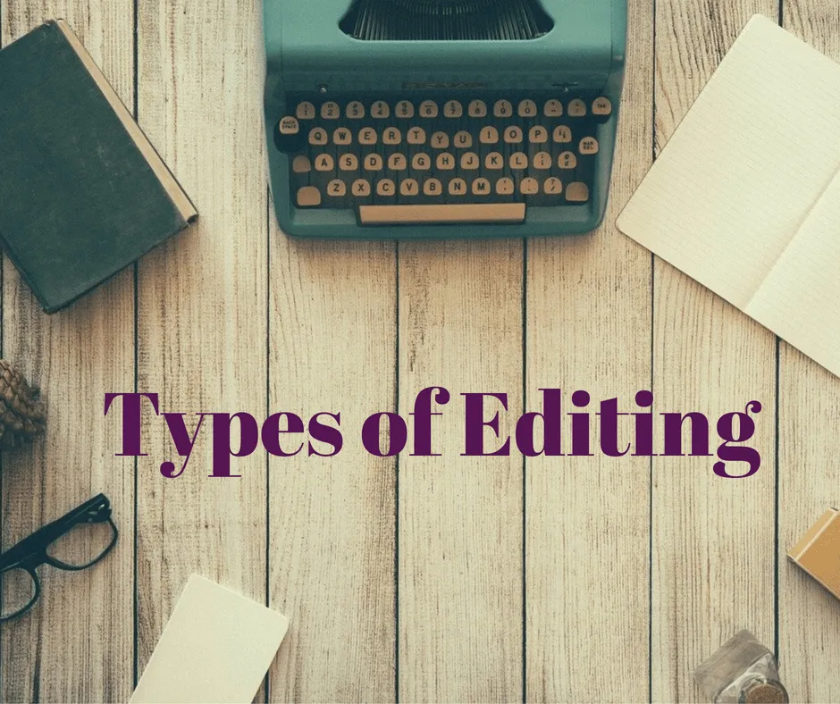
TYPES OF EDITING
1.DEVELOPMENTAL EDITING
2.LINE EDITING
3.COPY EDITING
4.PROOFREADING

Slide 5

The Editing Process
1.Review content for clarity,coherenceand consistency.
2.Check facts ,accuracy and validity.
3.Revise sentence structure ,grammar and punctuation.
4.Ensure style guide conformity
5.Final proofread.

Slide 6
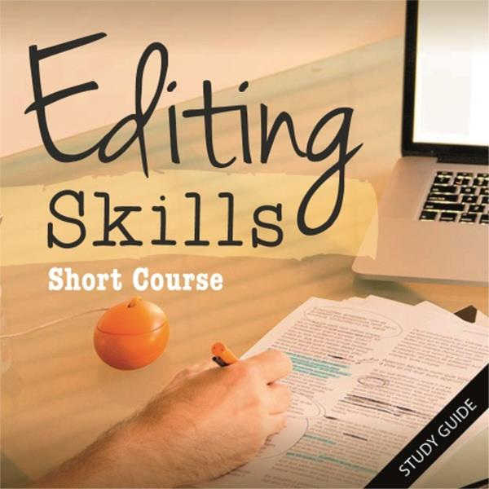
EDITING SKILLS
1.ATTENTION TO DETAIL
2.ANALYTICAL THINKING.
3.COMMUNICATION
4.PATIENCE
5.OBJECTIVITY

Slide 7

Tools For Editing
1.Grammarly
2.ProWritingAid.
3.Hemingway Editor
4.Style guides
5.Writing apps

Slide 8
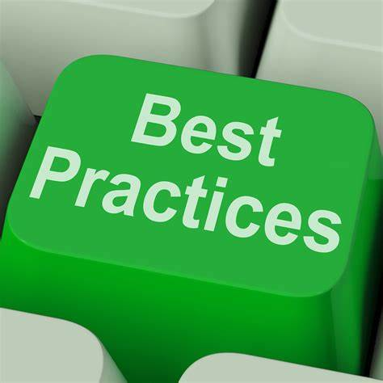
Best Practices
Take Breaks to maintain focus.
Use clear subtitles and titles.
Check for Consistency .
Read aloud .
Collabrate with others.

Slide 9

Conclusion
Summary: Editing ensures content quality, clarity and impact.
Call to action: Priortize editing for effective communication
Image: A Graphic representing refinement or improvement.

Slide 10
THANK YOU

